Slide 1
Installation Talend-Remote-Engine on Linux server
#Install compatible java version
cd /usr/lib
mkdir jvm
chmod -R 777 jvm
wget https://www.oracle.com/in/java/technologies/javase/jdk11-archive-downloads.html#license-lightbox
#extract the java file
tar -xvf jdk-11.0.17-linux-x64.tar.gz
#set the java path
cd /etc/profile.d
sudo vi jdk.sh
export JAVA_HOME=/usr/lib/jvm/jdk-11.0.18
export JRE_HOME=//usr/lib/jvm/jdk-11.0.18/jre (if jre is not in bin then remove the line)
export PATH=$JAVA_HOME/bin:$JRE_HOME/bin:$PATH
#reboot or restart the server to check java version
java -version

Slide 2
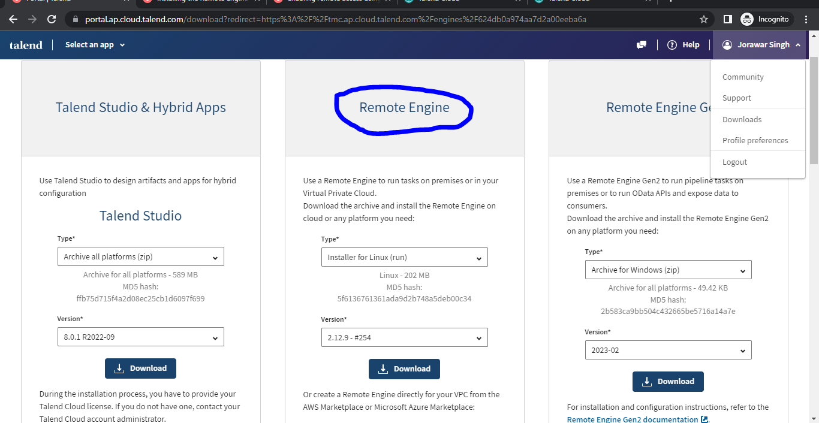
#got Talend cloud
#install the Talend-Remote-Engine latest version for linux

Slide 3
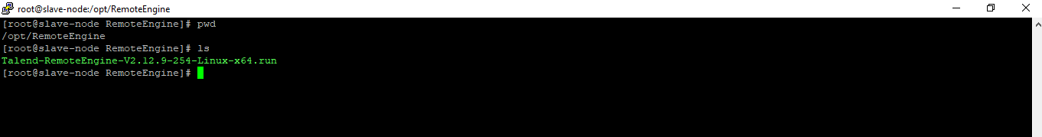
#goto the linux terminal
mkdir Remote-Engine
Cd /opt/Remote-Engine
#copy the Talend-RemoteEngine-V2.12.9-254-Linux-x64.run file from localhost to linux terminal
i)Use winSCp
Or
ii)Open PowerShell and goto downloads and run the command.
Scp –i localhost Talend-RemoteEngine-V2.12.9-254-Linux-x64.run Ubuntu@192.168.2.256:
#Give the permissions to the .run file
chmod –R 777 Talend-RemoteEngine-V2.12.9-254-Linux-x64.run

Slide 4
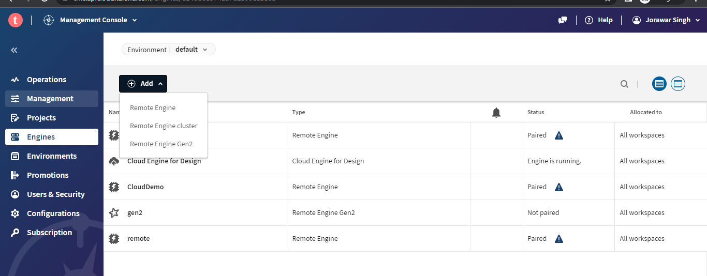
#Goto the Talend cloud
i)Select an app
ii)Management console
iii)Engines
iv)Add remote engine
v)Create a new remote-engine and save it

Slide 5
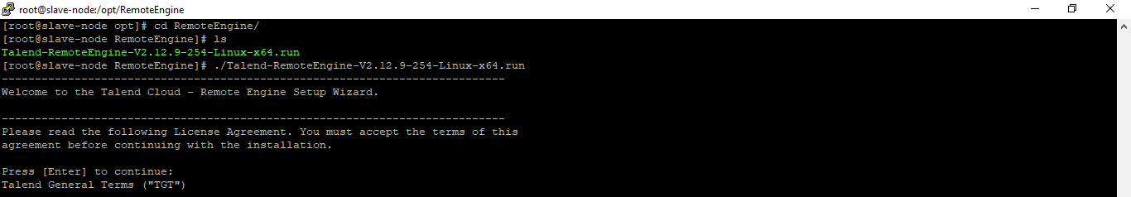
#goto linux terminal Install the remote engine
./Talend-RemoteEngine-V2.12.9-254-Linux-x64.run
(or)
## if want to install on single command ##
./<installer_filename> --mode unattended --installdir /opt/TalendRemoteEngine --region <xxx> --authkey
./Talend-RemoteEngine-V2.12.9-254-Linux-x64.run --mode unattended --installdir /opt/TalendRemoteEngine --region apac --authkey8<key generated on remote engine>68C2D590C23D0E8716A331CDEFFB68A

Slide 6
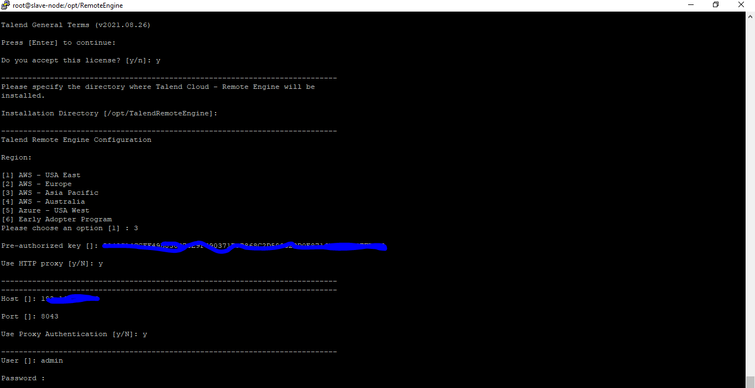

Slide 7
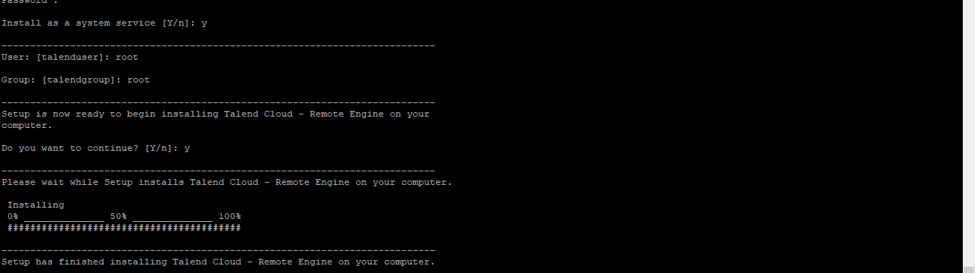
systemctl status talend-remote-engine
systemctl start talend-remote-engine
systemctl stop talend-remote-engine
Systemctl restart talend-remote-engine

Slide 8
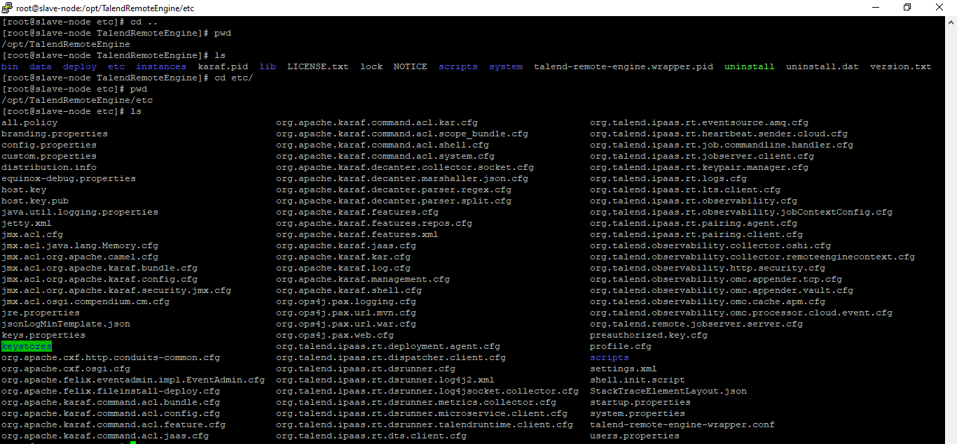
#got the talend remote engine installed path/directory
cd /opt/TalendRemoteEngine
cd /etc

Slide 9
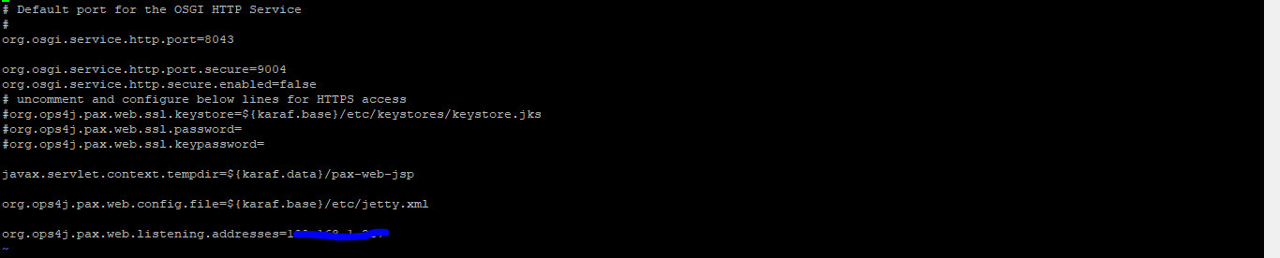
#stop the talend-remote-engine
systemctl stop talend-remote-engine
#configure the changes
vi org.ops4j.pax.web.cfg
#change the configuration
org.ops4j.pax.web.listening.addresses=<ip address> or <0.0.0.0>

Slide 10
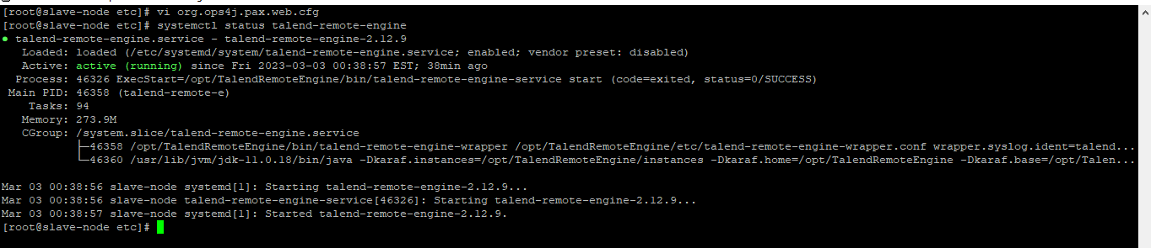
#restart the talend-remote-engine
systemctl start talend-remote-engine
systemctl restart talend-remote-engine
systemctl status talend-remote-engine
#goto web browser and acces the remote engine
http://<ip-address>:8043/configuration

Slide 11
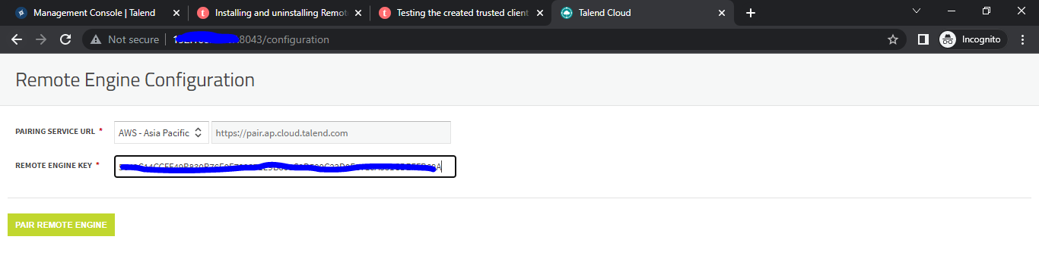
#goto talend cloud and check remote engine is paired
Reload the page and check once again

Slide 12
